Slide 1
Girls and Physics
Chris Meyer
York Mills C. I.
chris@meyercreations.com
www.meyercreations.com/physics

Slide 2
This presentation is available from my website
Research articles referenced here can be found through links in this PowerPoint

Slide 3
Our Problem
Demographics:
York Mills grade 11 physics: 40% female
York Mills grade 12 physics: 31% Female
First year university (U of T physics majors): 25%

Slide 4
Our Problem
Something is happening both before grade 11 and during high school physics
Our goals:
Try to understand what’s happening
Try to find some solutions

Slide 5
Possible Explanations
Interventions

Slide 6
Self-Efficacy

Slide 7
Self-Efficacy
Your belief that you can do something well
Self-efficacy is a significant predictor of success for all students.
Source: Unpacking Gender Differences in Students’ Perceived Experiences in Introductory Physics

Slide 8
Self-Efficacy
Even when controlling for exam score, females have significantly lower SE than males

Slide 9
Self-Efficacy
Males with no prior formal physics instruction showed the highest self-efficacy of any subgroup, suggesting a ‘male overconfidence syndrome’.
Source: Self-Efficacy of First Year University Physics Students: Do Gender and Prior Formal Instruction in Physics Matter?

Slide 10
Equipment Use

Slide 11
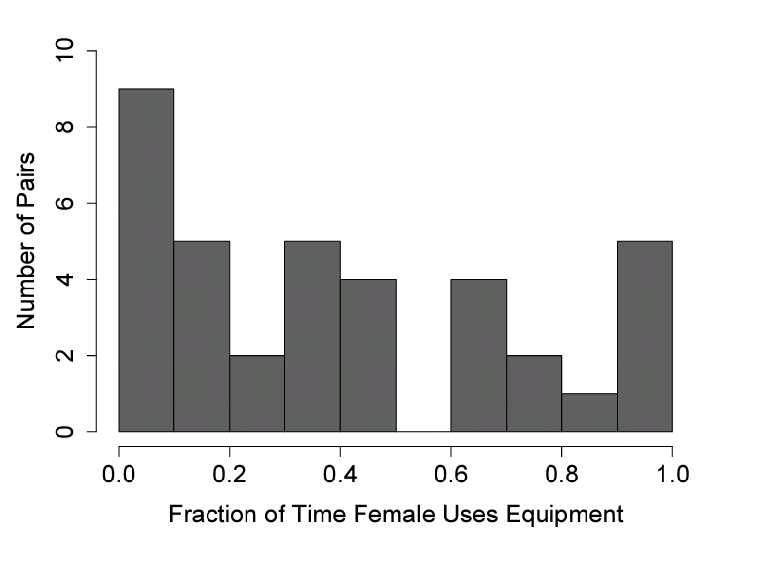
Equipment Use
UBC study of male-female pairs working on a Hooke’s law lab.
Source: Participating In The Physics Lab: Does Gender Matter?

Slide 12
Gendered Questions

Slide 13
Gendered Questions
Does changing the context of a physics problem affect how students respond to the question?
Source: Gender Differences in Student Responses to Physics Conceptual Questions Based on Question Context

Slide 14
Gendered Questions
From the Force Concept Inventory
The positions of two blocks at 0.20 second time intervals are represented by the numbered squares in the figure. The blocks are moving toward the right.

Slide 15
Gendered Questions
The revised question.
The position of two joggers, Ann and Pam, are shown below. The joggers are shown at successive 0.20-second time intervals, and they are moving towards the right.

Slide 16
Gendered Questions
Context has a clear effect on the response rate, but gender difference is still present

Slide 17
Physics Identity

Slide 18
Physics Identity
I feel like I could be a physicist
I feel like I belong in a physics classroom

Slide 19
Physics Identity

Slide 20
Physics Identity
Females report less of a sense of physics identity than males.
This, on its own, could contribute not only to the fewer number of females who go on to become physics majors, but also their lower performance in the course.
Source: Unpacking Gender Differences in Students’ Perceived Experiences in Introductory Physics

Slide 21
The Stereotype Threat
“the threat of being viewed through the lens of a negative stereotype, or the fear of doing something that would inadvertently confirm that stereotype”
Stereotype threat is likely a factor contributing to the gender gap in women’s exam scores and grades in physics
Source: The gender gap on concept inventories in physics: what is consistent, what is inconsistent, and what factors influence the gap?

Slide 22
Conceptual Understanding Gap

Slide 23
Conceptual Gap
Force concept inventory (FCI)
Used for 30 years to measure and compare basic conceptual understanding of force and motion
If you are not using this, you should!
Question: how much are girls learning compared with boys?

Slide 24
Conceptual Gap: Pre-Instruction
278
124
49%
58%
York Mills C. I. Toronto (IE)

Slide 25
Conceptual Gap: Pre-Instruction
Men consistently score higher on pre-instruction tests by about 10%
Source: The gender gap on concept inventories in physics: what is consistent, what is inconsistent, and what factors influence the gap?

Slide 26
Conceptual Gap: Post-Instruction
278
124
76%
82%
York Mills C. I. Toronto (IE)

Slide 27
Conceptual Gap: Post Instruction
The average difference in post-instruction test scores is about 10%

Slide 28
Conceptual Gap: Gain
How much do students improve due to Instruction?
Gain = amount improved
total possible improvement
On average males have a higher gain by 6%

Slide 29
Conceptual Gap: Gain
278
124
54%
59%
York Mills C. I. Toronto (IE)

Slide 30
Conceptual Gap: Specific Questions
Women, as a whole, do worse on every question on the FCI, though how much worse varies by question
greatest difference with questions 14 and 23
Source : The gender gap on concept inventories in physics: what is consistent, what is inconsistent, and what factors influence the gap?

Slide 31
Conceptual Gap: Specific Questions

Slide 32
Conceptual Gap: Specific Questions

Slide 33
Conceptual Gap: Specific Questions

Slide 34
Conceptual Gap: Explanations?
Do background factors explain the gap?
No: high school physics, ethnicity, declared major, high school calculus, high school GPA, physics self-efficacy, and identity , age, parents’ university education, and non-English home language

Slide 35
Conceptual Gap: Explanations?
Do background factors explain the gap?
Maybe: cannot tell from this analysis if the gender gap was partially explained by the SAT math score or not.
the gender gap is most likely the due to the combination of many small factors, rather than due to any one factor that can be easily modified.
Source: The gender gap on concept inventories in physics: what is consistent, what is inconsistent, and what factors influence the gap?

Slide 36
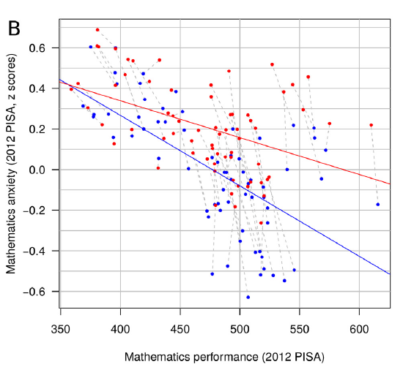
Math Anxiety?
Clear difference in levels of math anxiety
Source: Countries with Higher Levels of Gender Equality Show Larger National Sex
Differences in Mathematics Anxiety and Relatively Lower Parental Mathematics
Valuation for Girls (2016)
Blue = national average for boys
Red = national average for girls

Slide 37
Possible Explanations
Interventions

Slide 38
Interventions: Interactive engagement
Hope: Cooperative group learning or interactive engagement (IE) methods would close the gap

Slide 39
Interventions: Interactive engagement

Slide 40
Interventions: Interactive engagement
IE method significantly increase scores for male and female
gaps remain in many instances, reduced in others

Slide 41
Interventions: Self-Affirmation
A writing exercise to address the stereotype threat
Affirm one’s self-worth and integrity

Slide 42
Interventions: Self-Affirmation
the gender gap in the control group is 8% ± 5%,
the gender gap in the self-affirmation group is 1% ± 4%.
difficulties replicating (2012)
Source: Gender Differences in Physics 1: The Impact of a Self-Affirmation Intervention (2010)
Source: Replicating a Self-Affirmation Intervention to Address Gender Differences: Successes and Challenges (2012)

Slide 43
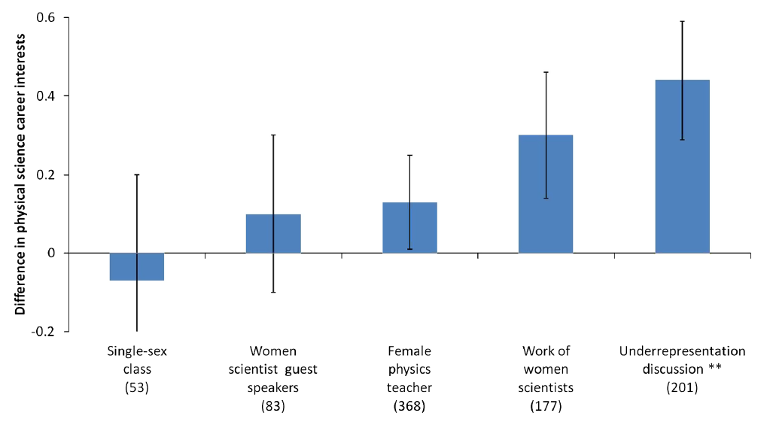
Other Possible Interventions?
Source: Factors that affect the physical science career interest of female students: Testing five common hypotheses (2013)

Slide 44
Intervention: Ask them, Find them
Roberta Tevlin from Danforth Tech in Toronto led an optional attendance STEM program with low female enrollment
Asked her female students for feedback
Promoted the program with female-only engineering competitions for the feeder schools

Slide 45
Intervention: Ask them, Find them
Most recent: 58%! Yay, Roberta!

Slide 46
How is my school doing?

Slide 47
Conceptual Learning

Slide 48
Grade 11 Forces

Slide 49
Compared with Marks?

Slide 50
Attitudes Towards Learning

Slide 51
This Should Concern Us
If:
You think physics is interesting
You think physics is important
You think we need to make use of the potential of our whole population

